Slide 1
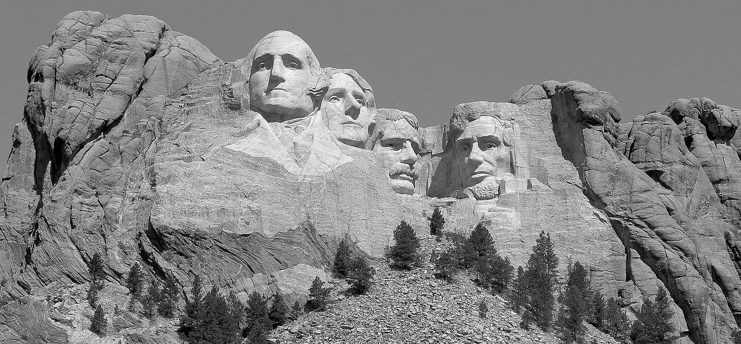
Mount Rushmore

Slide 2
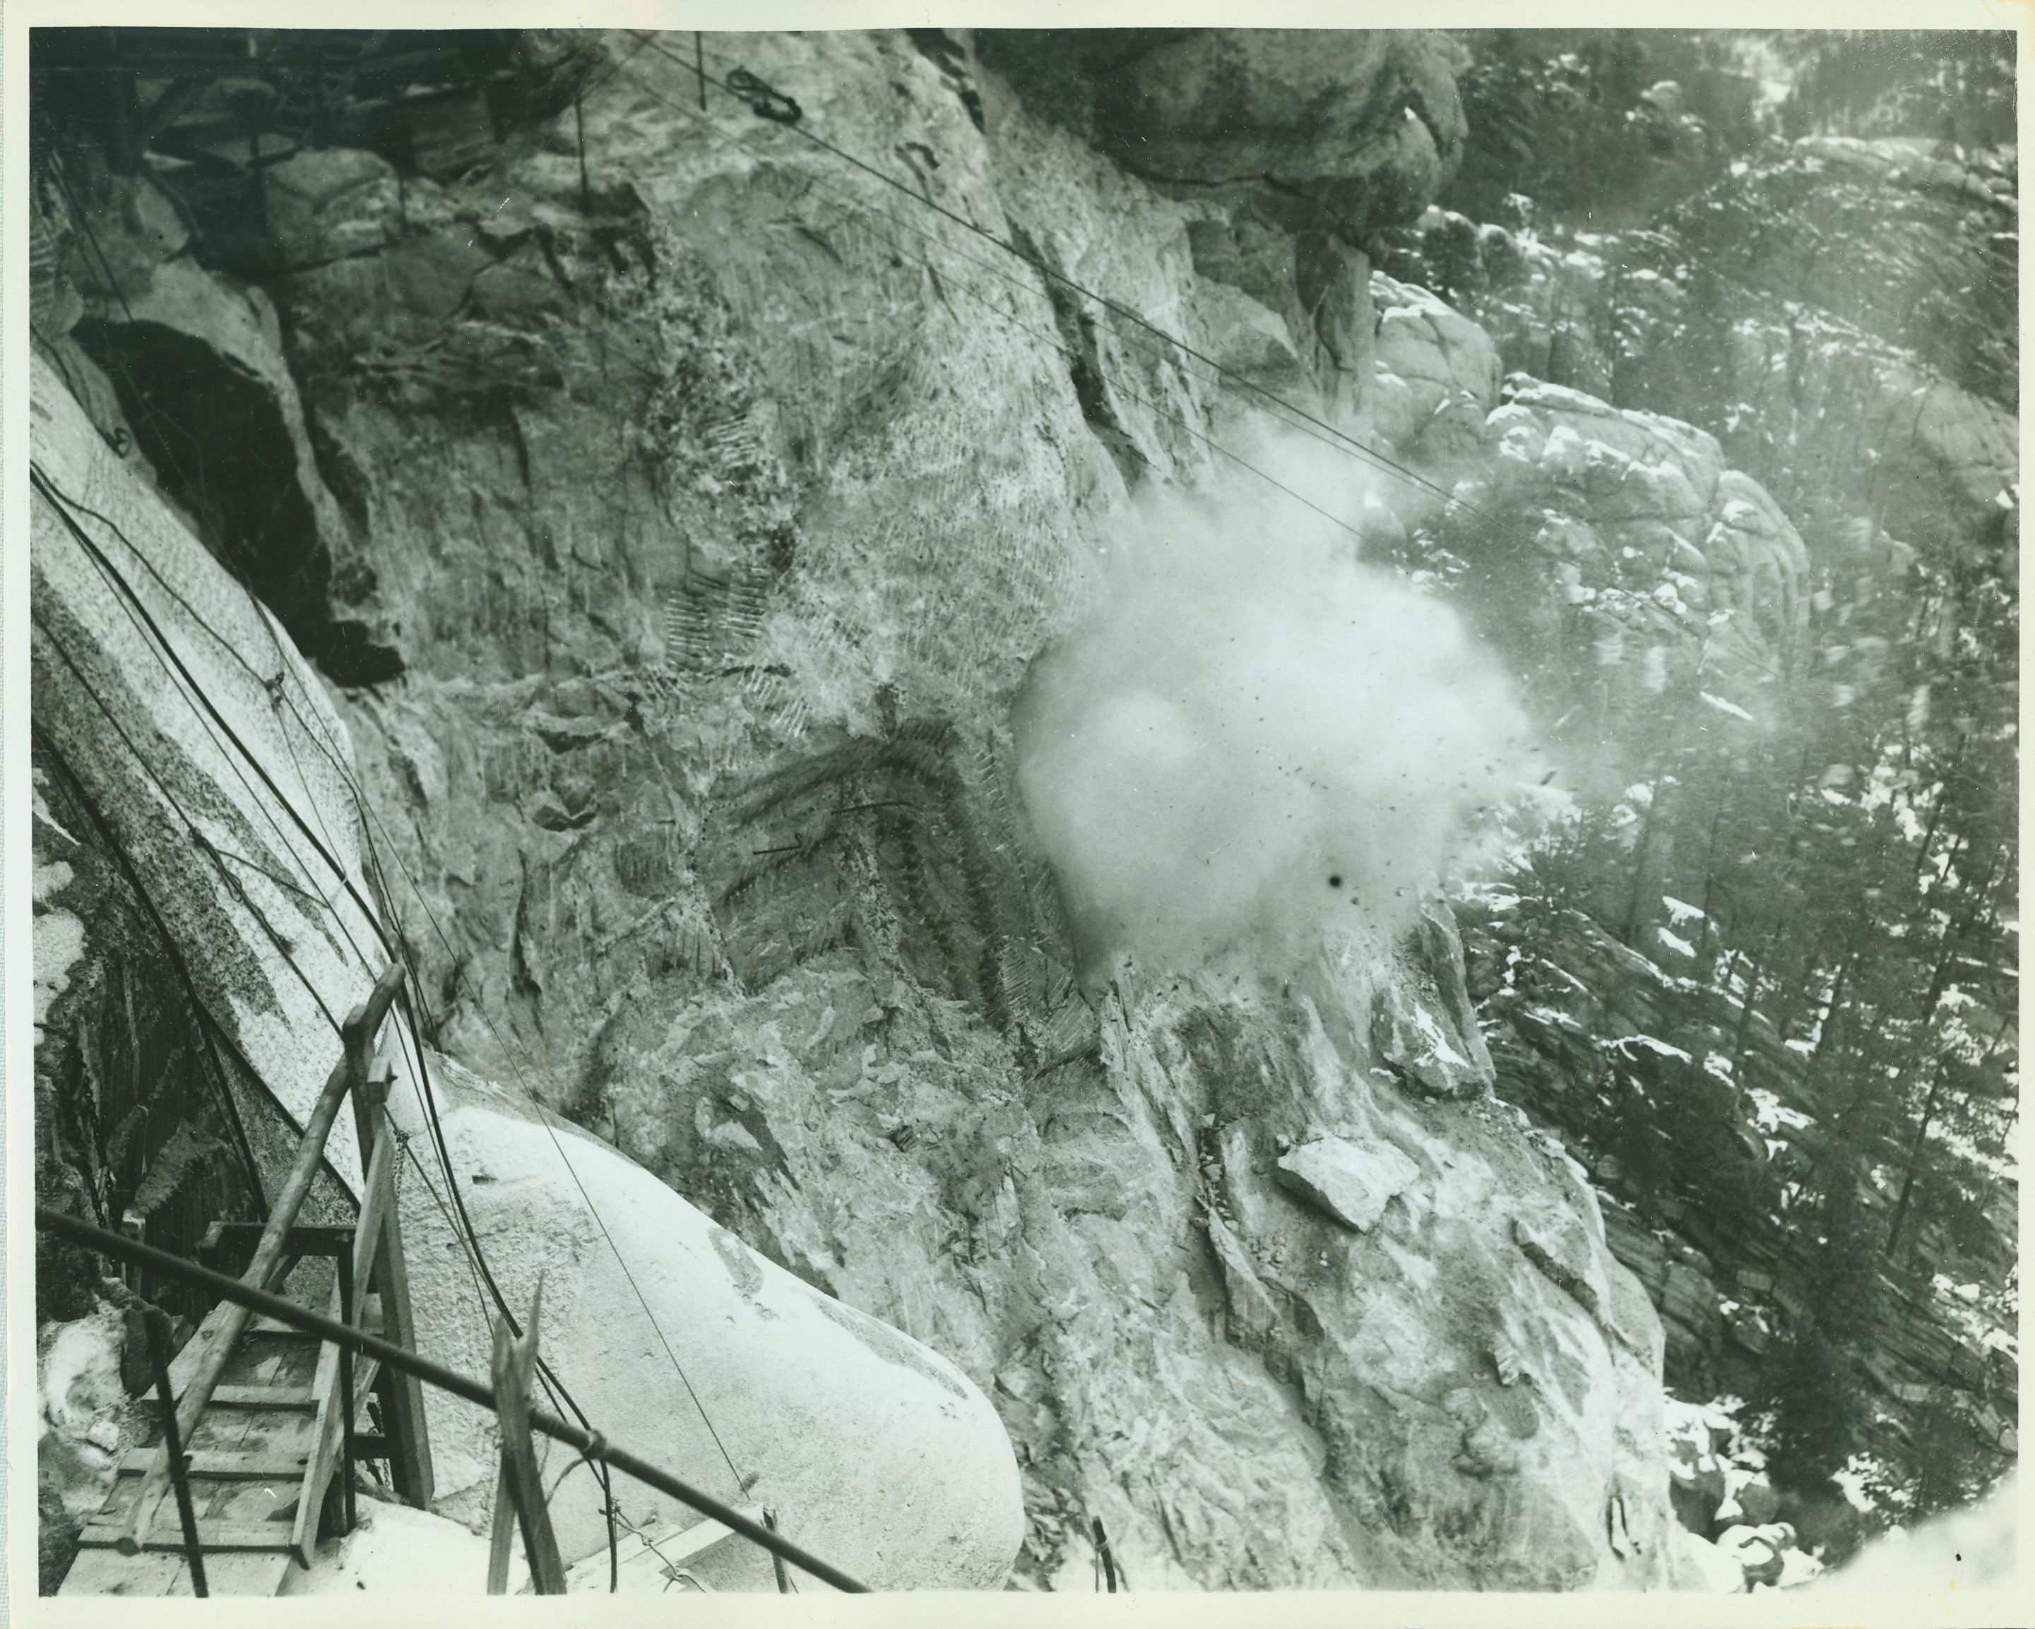
Overview
The project began in December of 1923 when the state historian of South Dakota suggested a sculpture in the Black Hills.
In order to create the sculpture 820,000,000 pounds of rock were blasted off the mountainside, the details were carved with drills, and these smaller pieces were removed by hand.
On October 31, 1941, Mount Rushmore National Memorial was declared a completed project.

Slide 3
The Central Figures
Doane Robinson
John Boland
William Williamson
State Historian of South Dakota
President and General Manager
Representative for South Dakota
Conceived the original idea
Invited Borglum to visit and talk over the project
Worked to secure funding to start the project
Worked with Robinson to secure the initial funding
Maintained adequate funding for the project––even through the Great Depression
Petitioned Congress to appropriate the project funds
Convinced President Coolidge to visit the Black Hills on a summer vacation

Slide 4
The Central Figures (cont.)
Peter Norbeck
Gutzon Borglum
Lincoln Borglum
US Senator for South Dakota
Sculptor
Pointer; Chief Pointer; Sculptor
Orchestrated the political and legislative means for federal support during times when funding was difficult to obtain
Oversaw all sculpting operations for the project
Conducted world tours to raise funds
Worked for several years without pay in different positions
Took over the role of sculptor after his father's death

Slide 5
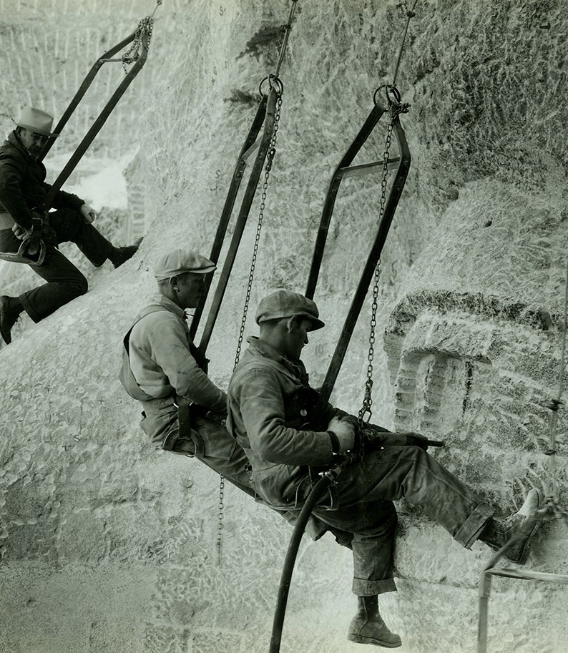
The Workers
Almost 400 men and women labored for fourteen years to create Mount Rushmore. The laborers worked long hours for low pay, with little certainty as to how long he would be employed.
Despite dangerous and harsh conditions, their were no fatalities during the carving work.
Learn more about the carving work at https://www.nps.gov/moru/learn/historyculture/carving-history.htm.

Slide 6
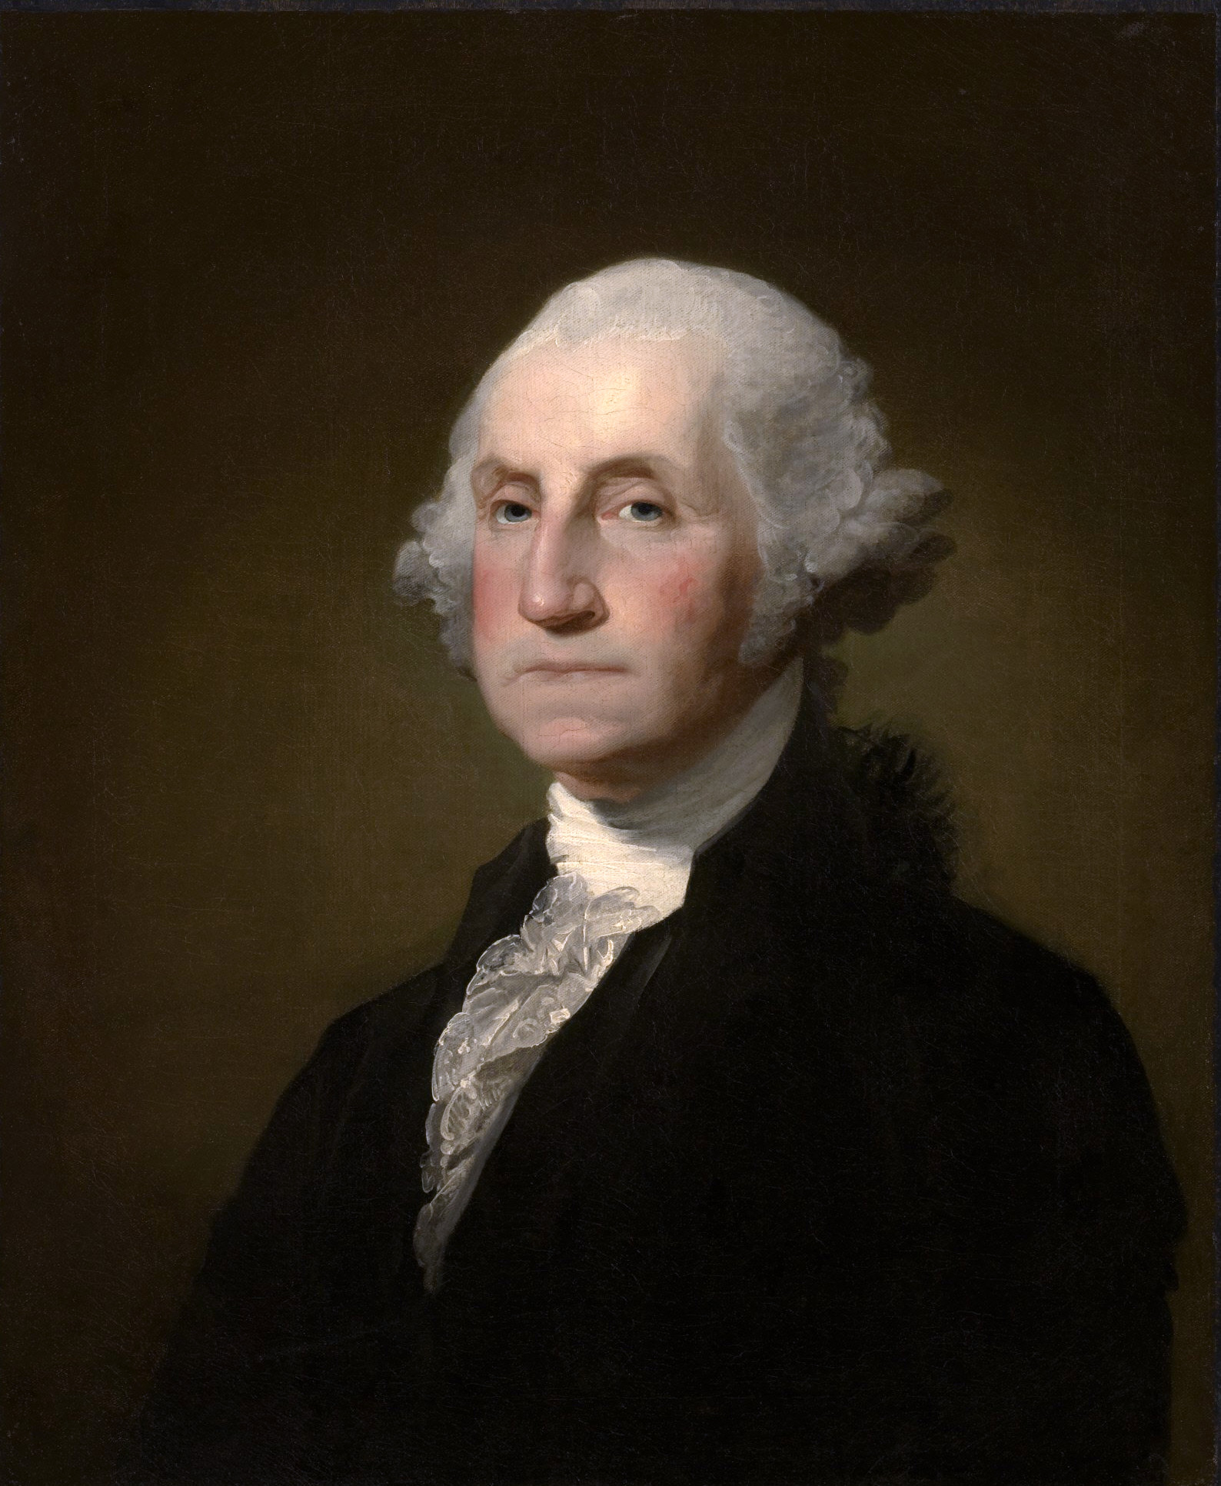
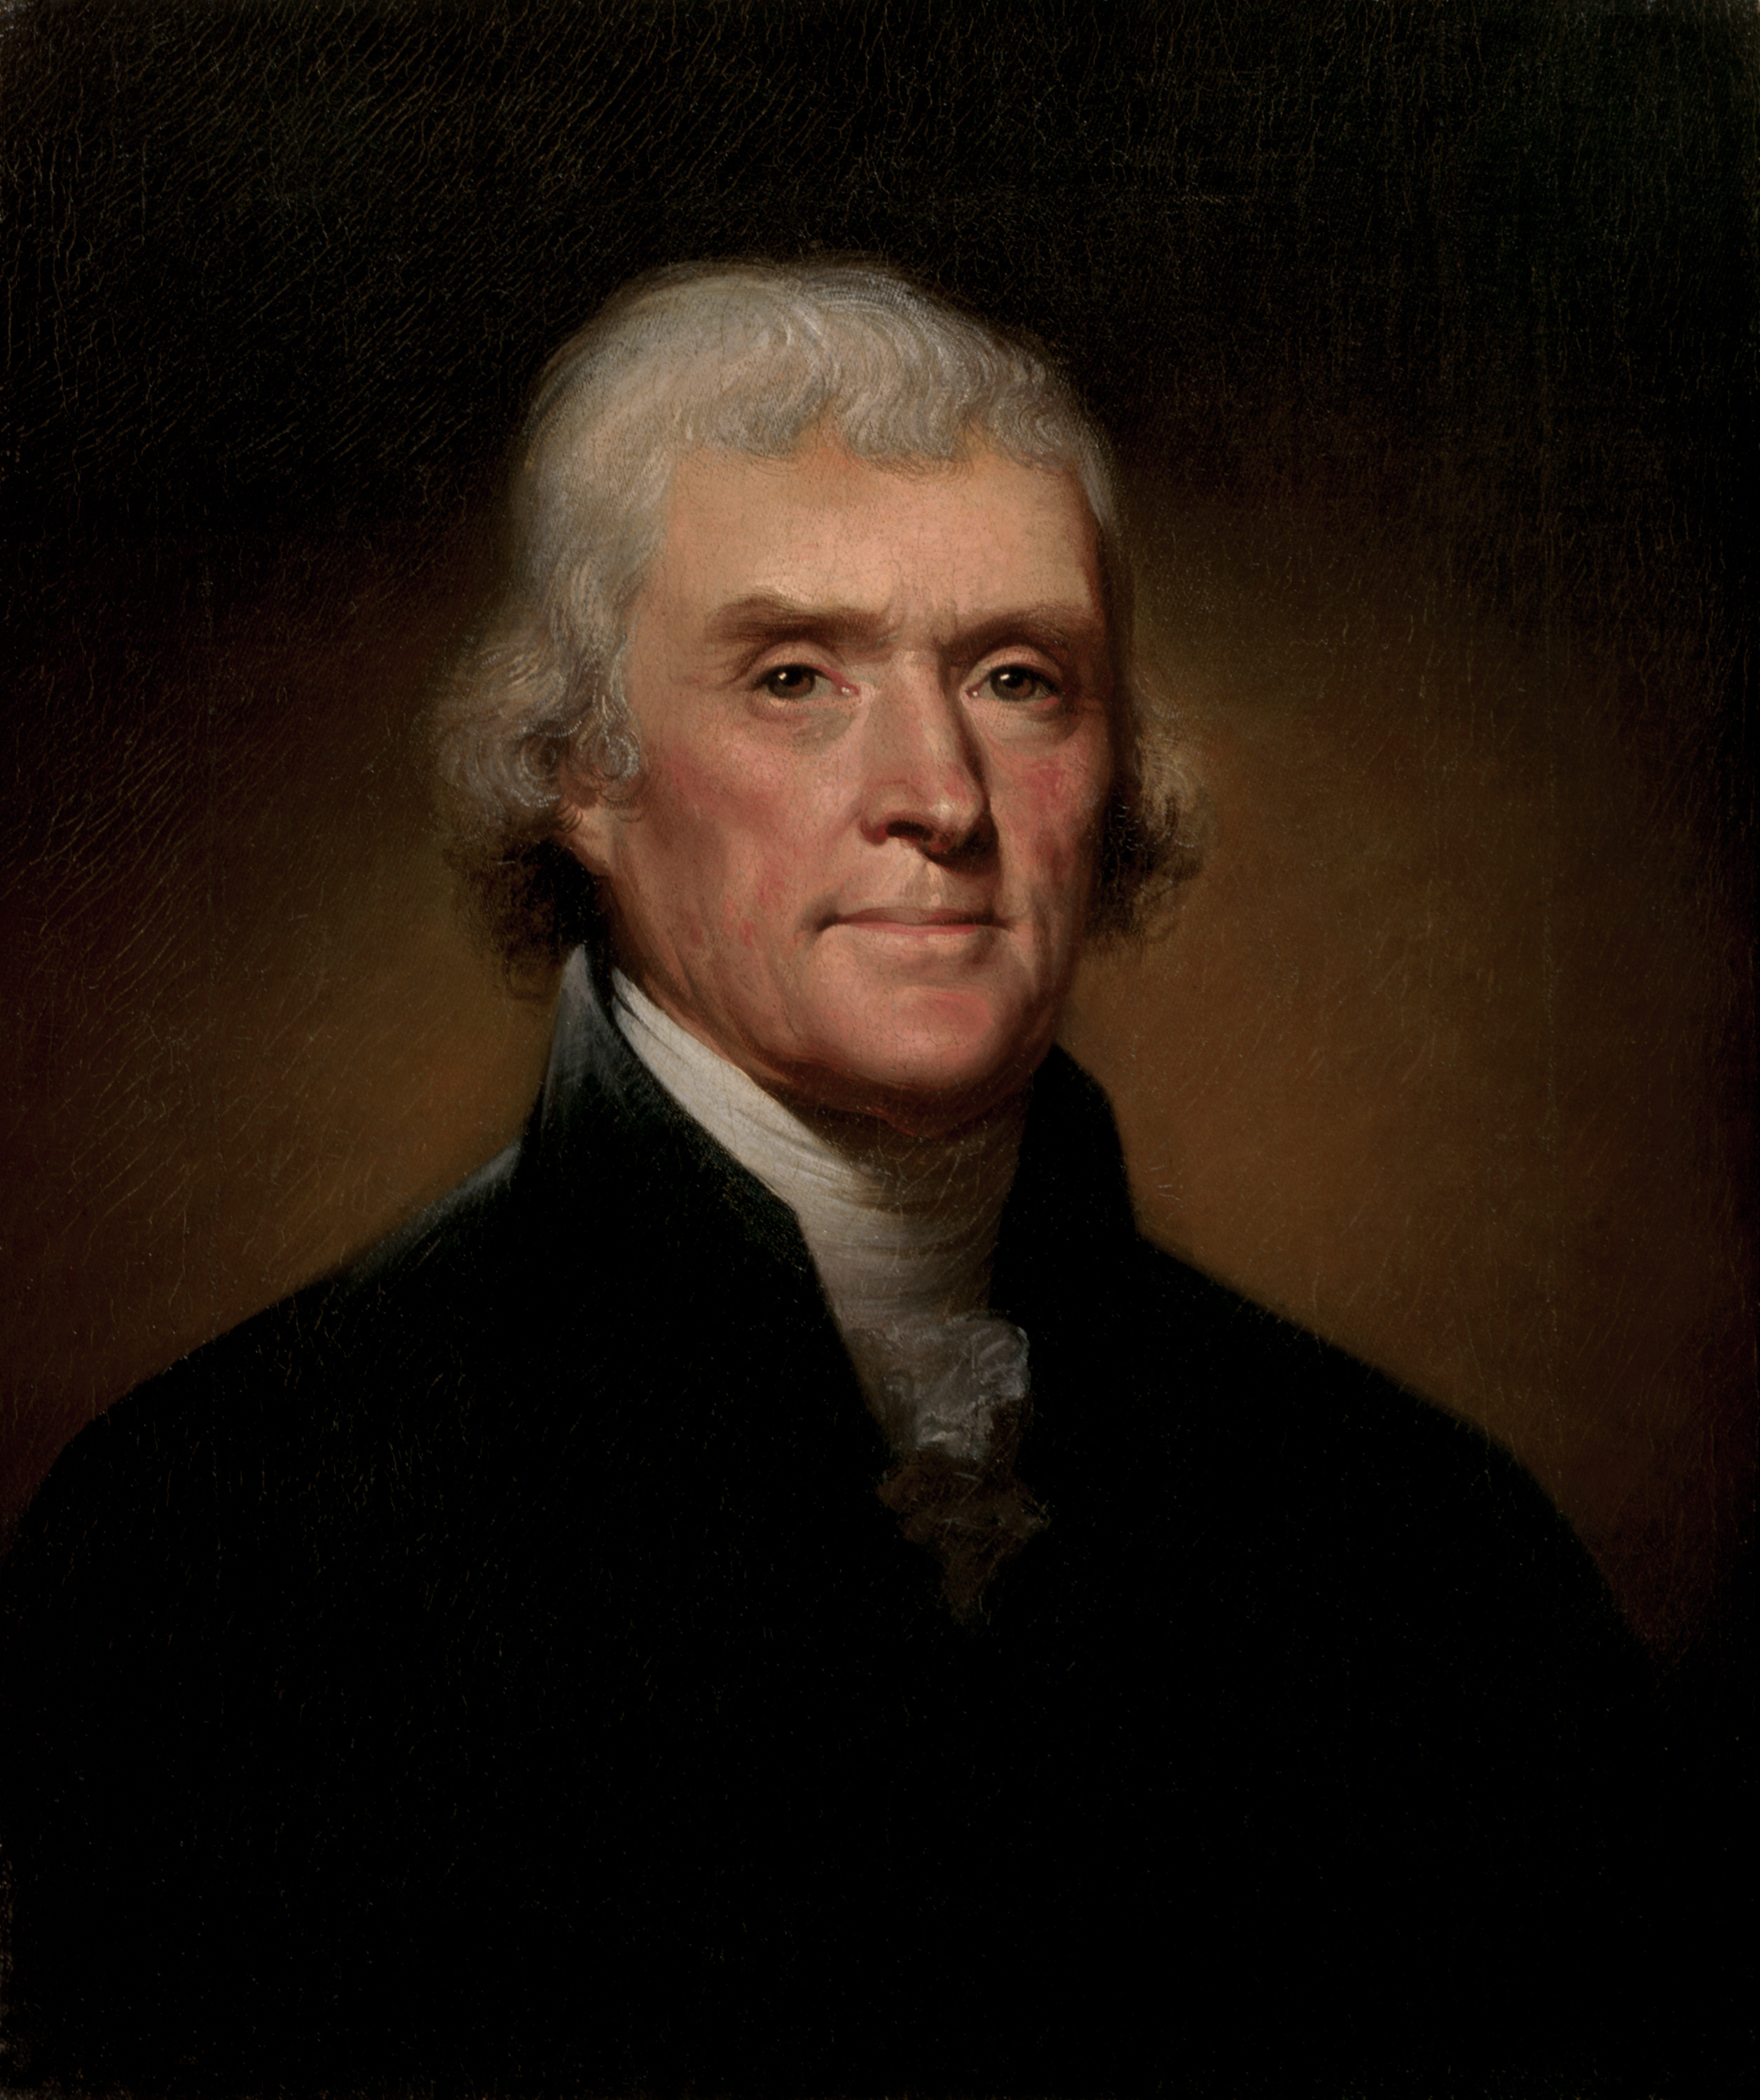
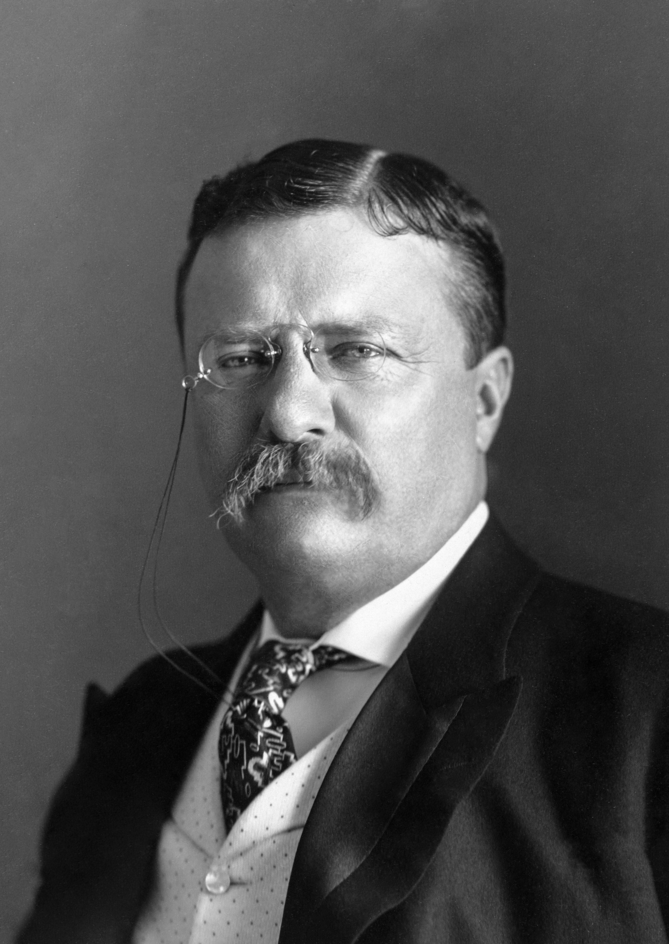
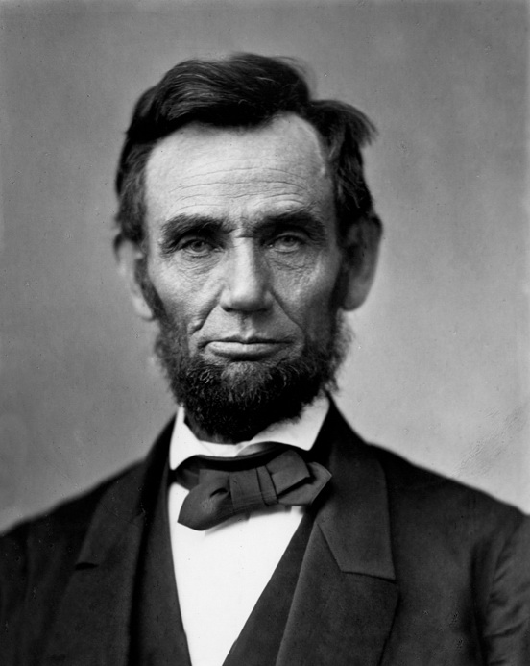
The presidents
Borglum chose the four presidents that he believed represented the most important events in the history of the United States. From left to right the presidents pictured below are Washington, Jefferson, Roosevelt, and Lincoln. Each man’s portrait is linked to his Wikipedia page.

Slide 7
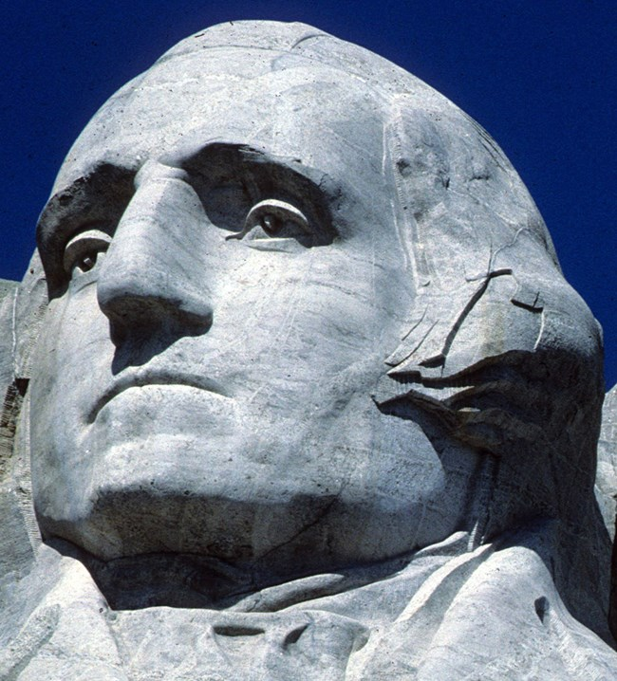
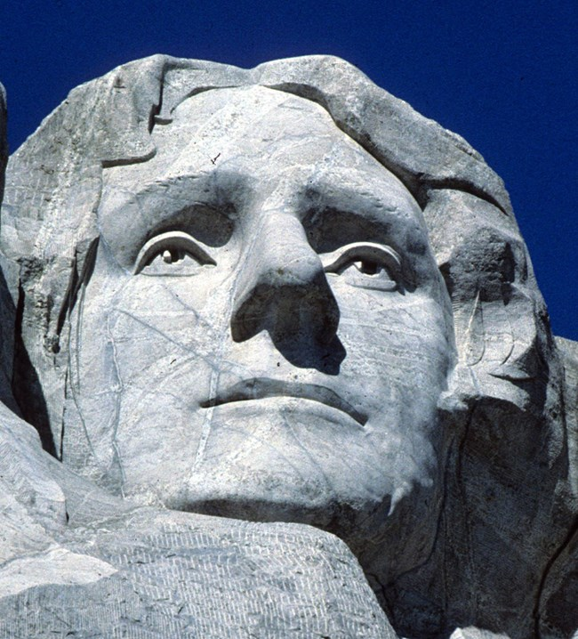
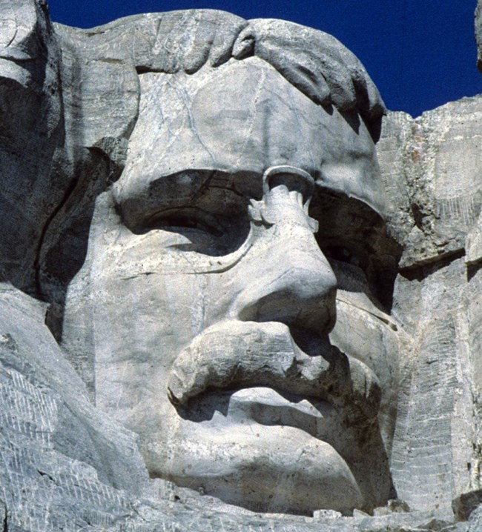
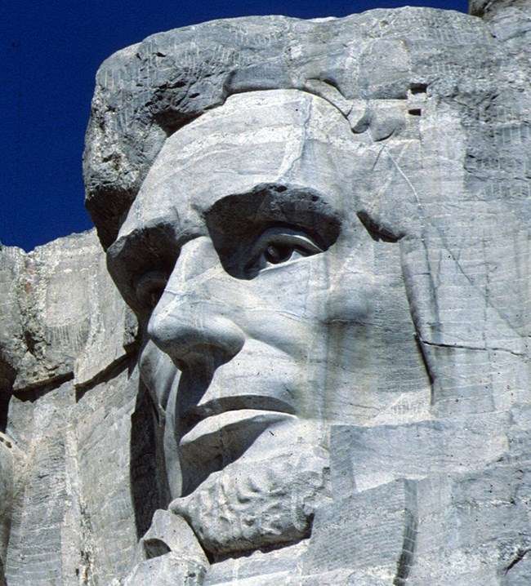
George Washington
Thomas Jefferson
Theodore Roosevelt
Abraham Lincoln

Slide 8
Today’s Visitors
The park is open seven days a week––all year––with the exception of December 25. Over two million people visit the park each year.
Park Attendance
Year | Visitors
2010 | 2,331,237
2011 | 2,081,722
2012 | 2,185,447
2013 | 2,162,998
2014 | 2,144,808
2015 | 2,434,297
Over the years, new visitor facilities have been added, including a visitor center, the Lincoln Borglum Museum, and the Presidential Trail.

